Slide 1
Cybersecurity
Phishing and Ethical Hacking

Slide 2
Introduction
Cybersecurity high-level topics
Information Security
Phishing
Ethical Hacking
Legislation
Pentesting
Tools

Slide 3
Information Security
Maintaining:
Confidentiality
Integrity
Availability

Slide 4
Phishing
“ Phishing is a type of social engineering where an attacker sends a fraudulent (e.g., spoofed, fake, or otherwise deceptive) message designed to trick a person into revealing sensitive information to the attacker or to deploy malicious software on the victim's infrastructure like ransomware ”
Wikipedia
Spear Phishing – targeted at a specific person or organisation

Slide 5
Phishing

Slide 6
Phishing
http://equalgrow.store/r47cf.php?32=1o10637125e87e2f4_1qo4.89uatv9.A0184rfffsy1wc07pt_0t2256.028gmMDk2dXkyMXBqbmpp0r5djf

Slide 7
Phishing
http://equalgrow.store/r47cf.php?32=1o10637125e87e2f4_1qo4.89uatv9.A0184rfffsy1wc07pt_0t2256.028gmMDk2dXkyMXBqbmpp0r5djf
https://dolocamerticus.live/?304a670e17b7f960c21a33723214d1b1

Slide 8
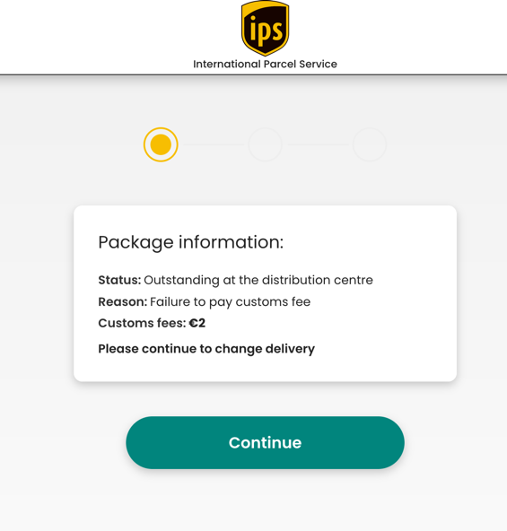
Phishing

Slide 9
Phishing

Slide 10
Phishing
This is a special offer for a limited period of 3 days which comes with a £13.00 welcome gift card to explore and buy products on one of our affiliates’ websites. By acquiring this membership you will be automatically enrolled in our affiliate membership services. The membership fee amount is £41.14 which will be automatically deducted every 14 days unless skipped or canceled. You can cancel the service at any time with a 30 days cancellation period or pay £6.08 for immediate opt-out. This campaign will expire on Dec 13.

Slide 11
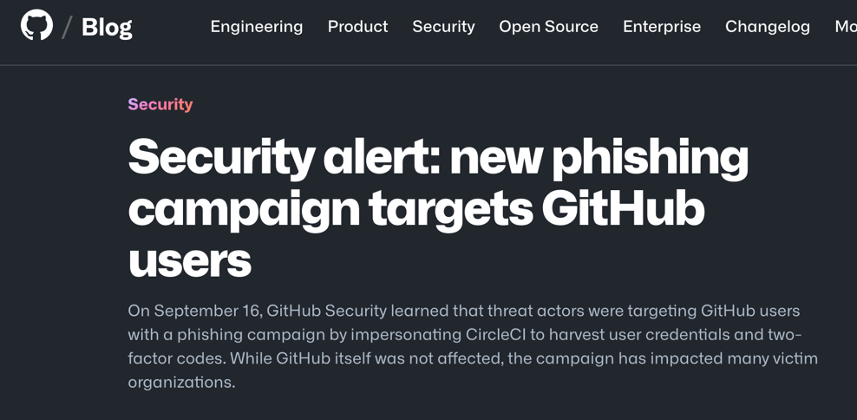
Spear Phishing

Slide 12
Ethical hacking
Hats
White hat
Penetration testing
Done with the consent of target
Black hat
Done with malicious intent
Grey hat
Done without consent but also with malicious intent

Slide 13
Legislation
Computer Misuse Act 1990
Regulation of Investigatory Powers Act 2000
The Privacy and Electronic Communications Regulations 2003
UK General Data Protection Regulation (GDPR)

Slide 14
Pentesting
Blue team
Defending an organization from cyber attack
Testing effectiveness of monitoring and blocking
Red team
Trying to break-in to the organization
Rules of engagement
The ”fun” bit

Slide 15
Pentesting - reconnaissance
DNS Enumeration
Network scans
Google
LinkedIn

Slide 16
Pentesting – Gaining Access
Spear phishing!
Brute force attacks
Exposed network ports
Physical access
Website vulnerabilities
Watering hole attacks

Slide 17
Pentesting – Pivot!

Slide 18
Tools of the Trade

Slide 19
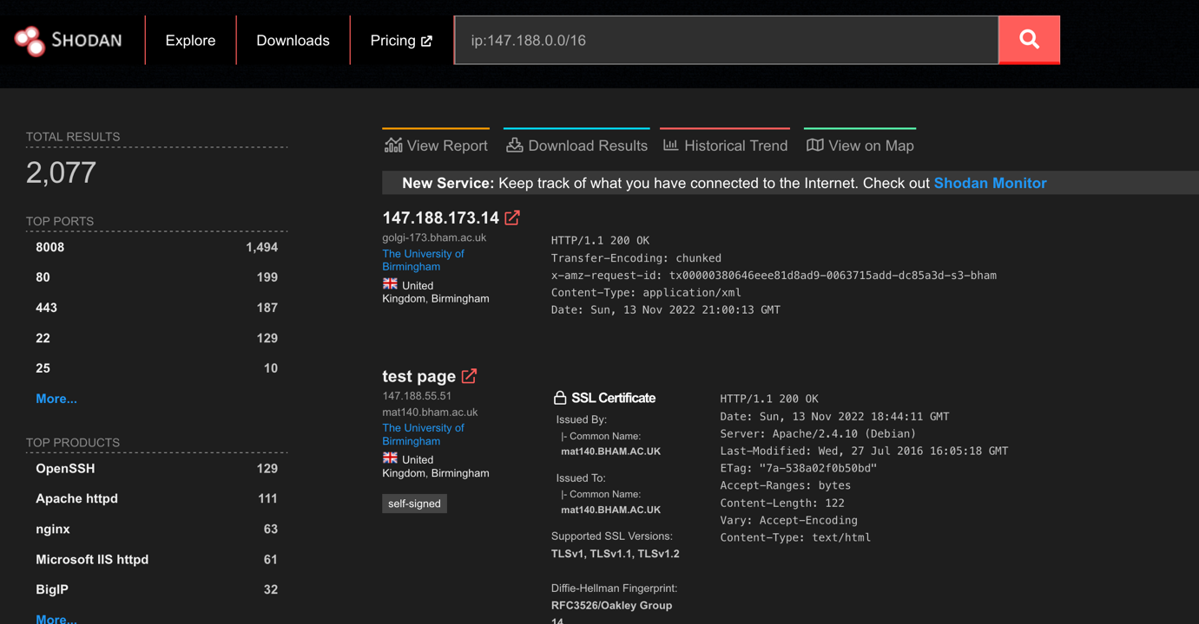
Tools of the Trade

Slide 20
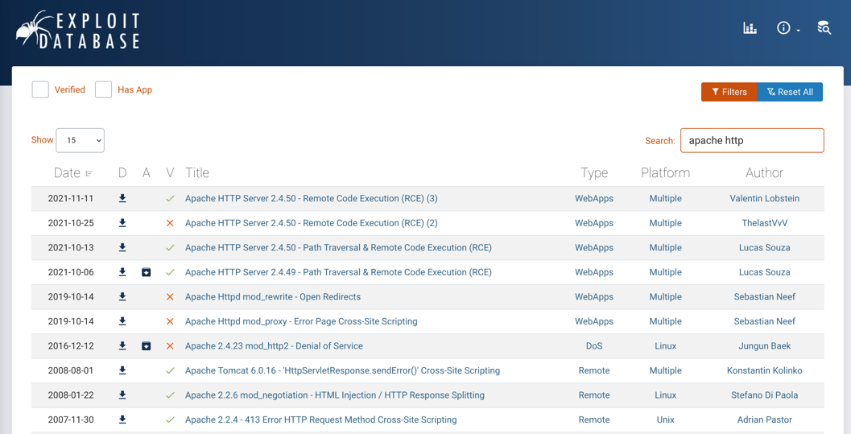
Tools of the Trade

Slide 21
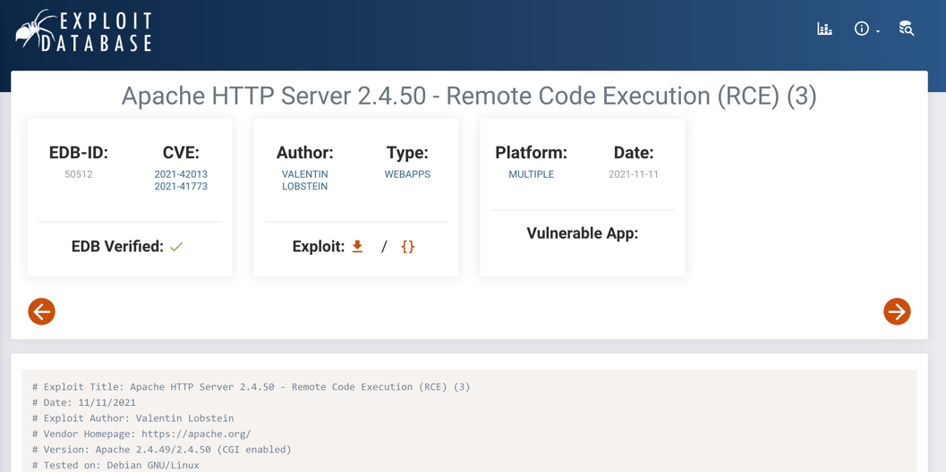
Tools of the Trade

Slide 22
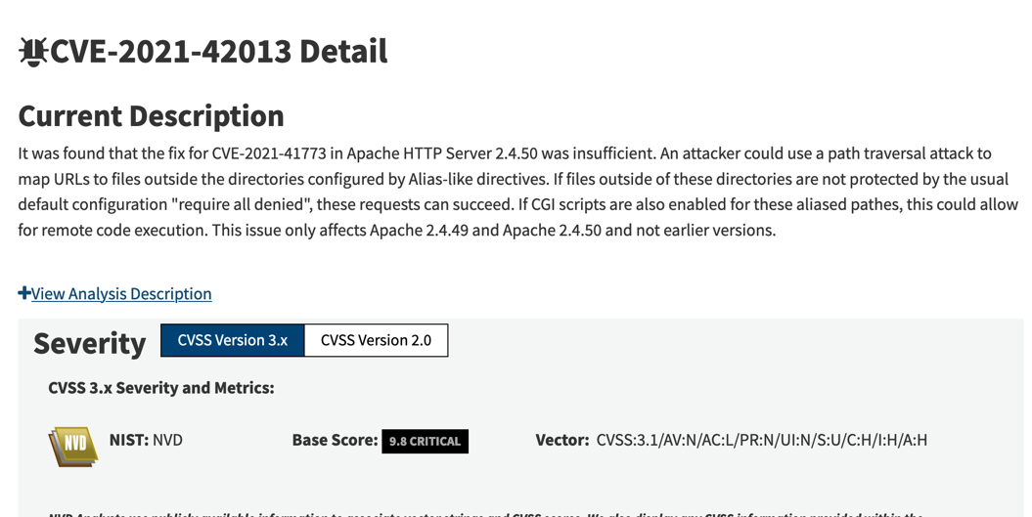
Tools of the Trade

Slide 23
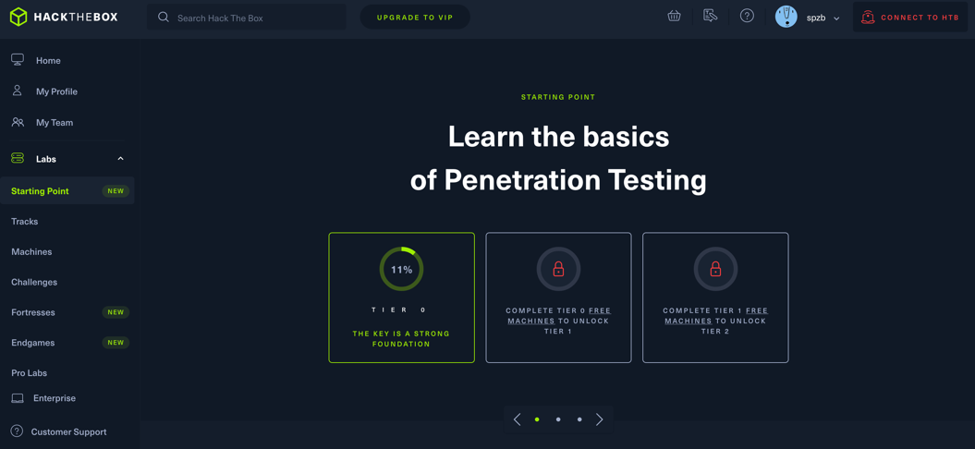
Learning and Practicing (CTF)

Slide 24
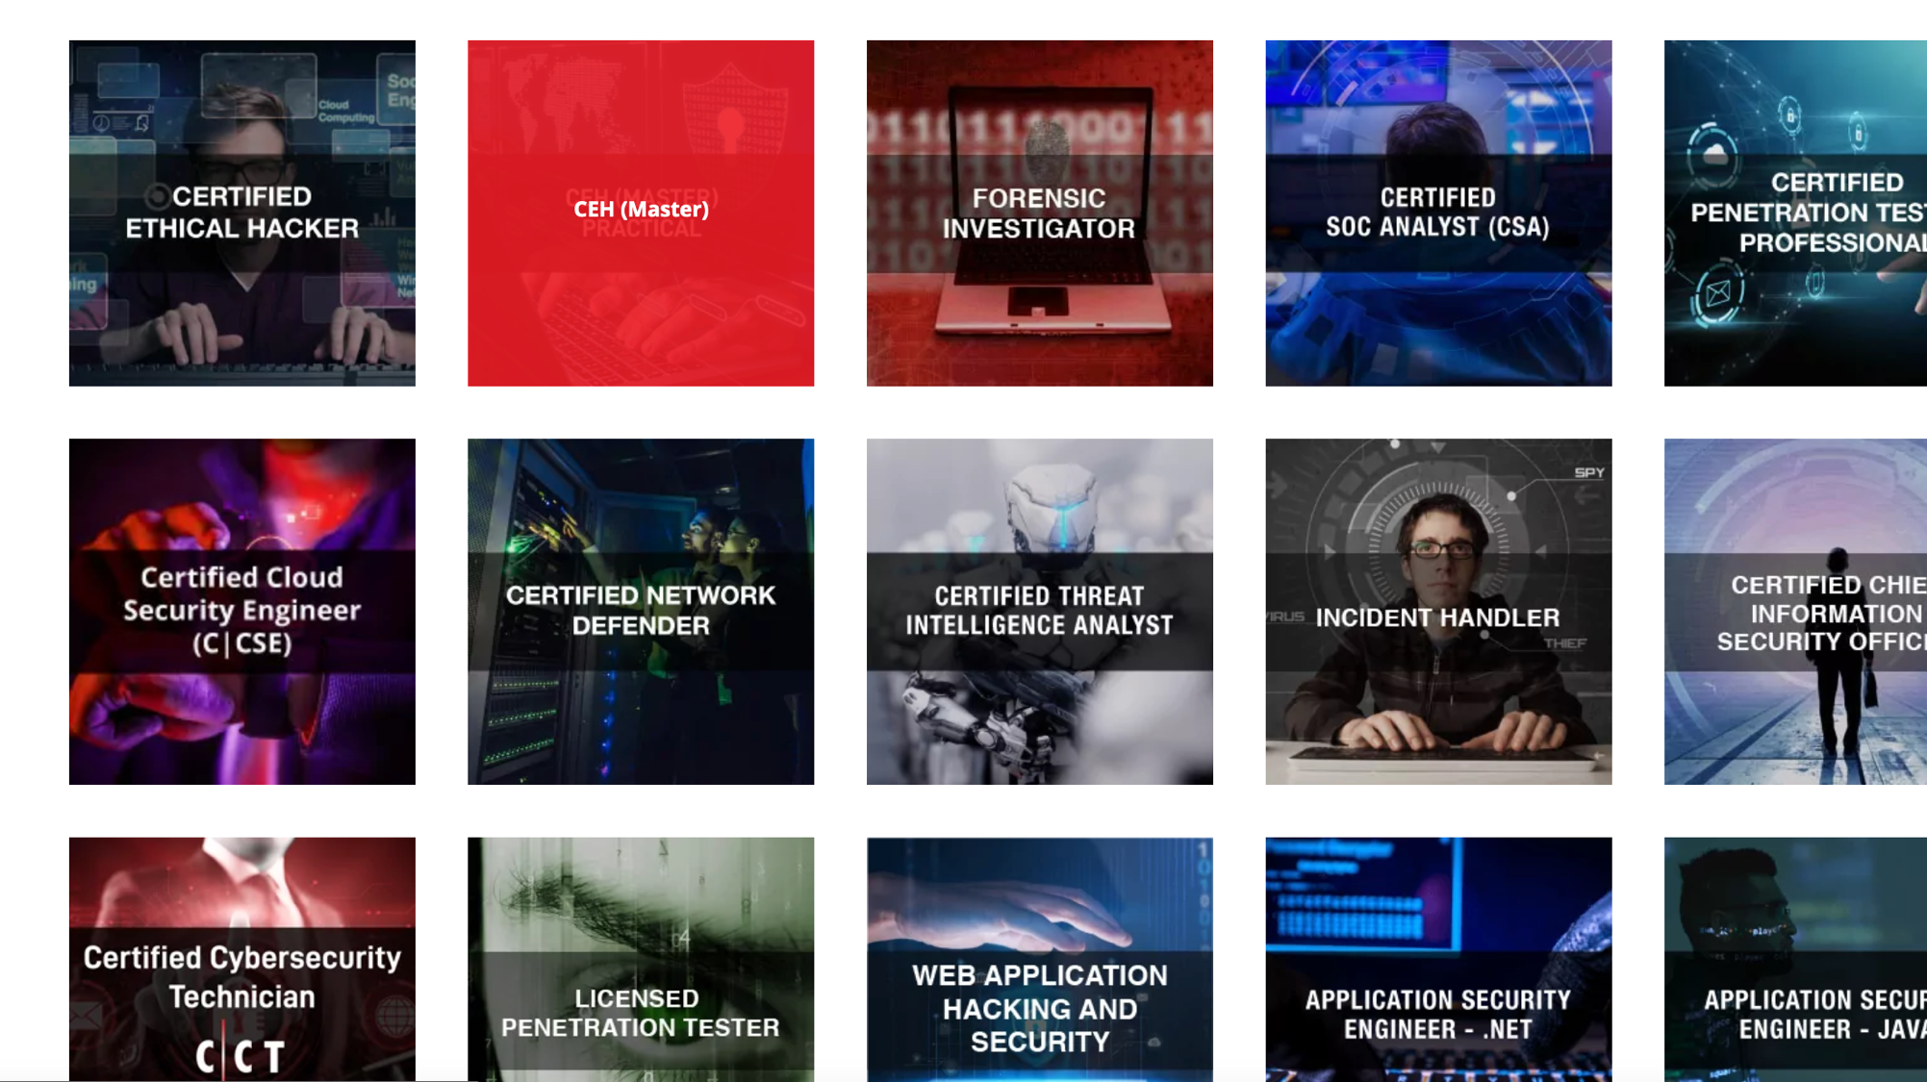
Certification

Slide 25
Next steps
https://github.com/husnainfareed/Awesome-Ethical-Hacking-Resources
https://github.com/vitalysim/Awesome-Hacking-Resources
https://www.kali.org/
https://www.shodan.io
https://www.exploit-db.com/
https://www.eccouncil.org/ethical-hacking/

